Slide 1

IBEX Initial Training Workshop
Experimental Controls Team
ISIS

Slide 2
Contents
General Introduction
  Running IBEX
  Dashboard
  System Views
Configurations
Synoptics
Basic Scripting (Time Permitting)
Notes:
Purpose of today’s presentation is to talk about configuration and synoptics within IBEX
Prepared some slides with info on (in black) and tasks to try (to green)
But you are in control this is to help you so can ignore slides. Ask questions whenever and you can choose the order
Today’s session is scheduled to last 2 hour (but room is booked for 3)

Slide 3
Contents
Format
  Information in black
  Tasks in green
You are in control
  Ask questions
  Choose the order and depth
    If you want to spend more or less time on a section please just let us know
Slides are available in a folder on your desktop

Slide 4


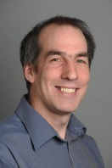

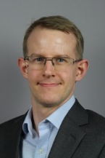









IBEX team
Kevin Woods
Freddie Akeroyd
John Holt
Kathryn Baker
Rory Potter
Dominic Oram
Alistair McGann
Tom Willemsen
Gareth Howells
David Keymer
Thomas Löhnert
Christopher Morten-Smith
James
King
Aaron
Long

Slide 5
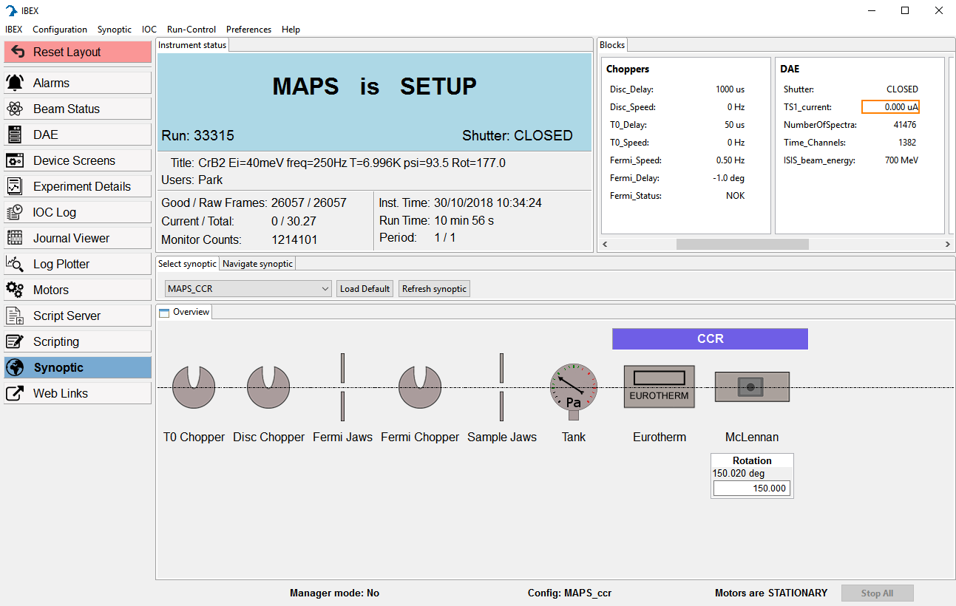
Notes:
Main IBEX GUI: launched from the start bar
When showing IBEX for the first time, give a 2 minute overview of things it can do as a trailer for what’s to come. This will give those fresh to IBEX a context for what it is and why it exists before leaping into the underlying architecture

Slide 6

SECI + IBEX
Notes:
SECI and IBEX shouldn’t be run concurrently
May appear to be working but problems underneath
Closing the IBEX gui is not sufficient to stop IBEX

Slide 7
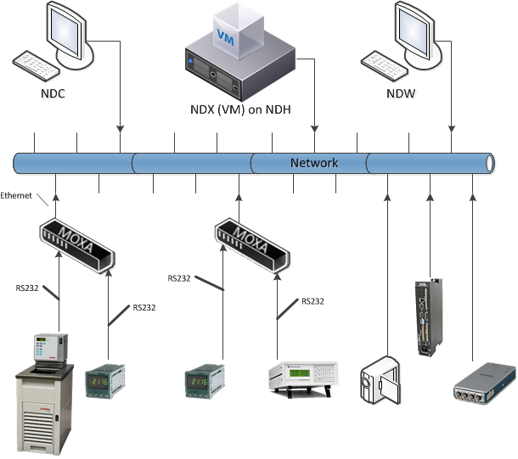
Hardware Interaction
Notes:
Two sorts of devices:
Hardware devices – measurement and control
Computer monitoring those devices – mention NDC, NDX and NDW
All connect to a network and they can communicate on that network. Some devices don’t talk network and we use MOXA’s to enable them to be placed on the network
Some connections are private

Slide 8
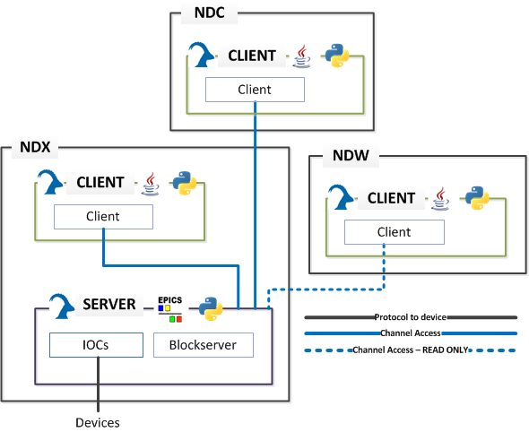
Software Interaction
Notes:
Shows Software Interactions
The client is separate to the server.
NDX runs
IBEX server (responsible for control)
IBEX Client to communicate with server
NDC runs
IBEX client and talks to the server and controls it
NDW
Desktop machine can only view the server
Some of these names will become more familiar as you use IBEX.
There are some changes to come to this, as the Script Server will alter some of these interactions.
This session will focus on the client, as that is the user interface of the system, and where the vast majority of interaction with the server should occur.

Slide 9
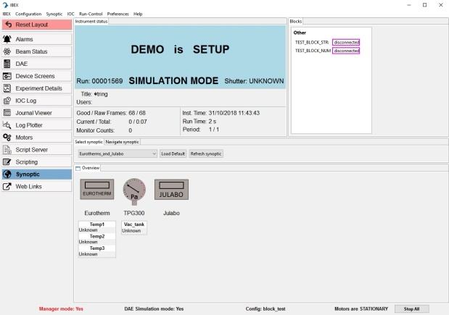
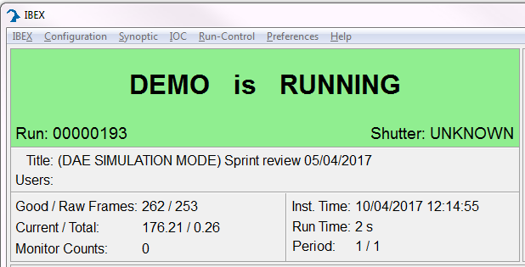
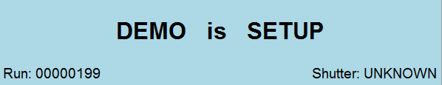
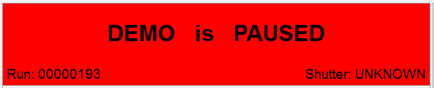
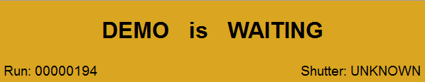

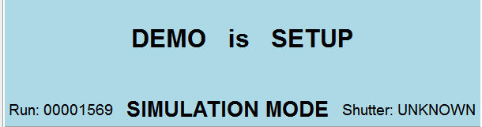
Dashboard
Notes:
Shows the state of the DAE
Light blue - Setup not running but ready to be run
Green – running collecting data
Red – paused, not collecting data
Orange – waiting or veto
Waiting – a block is outside of run control limits and the data to not being collected
Veto – an external veto has triggered on the DAE and it is not collecting data
Also shows experiment title, users, frames and other information about the current run

Slide 10
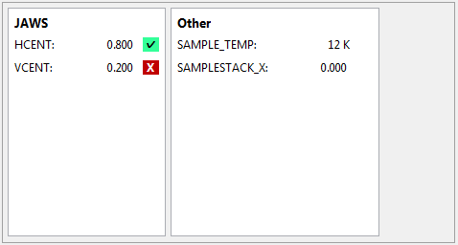
Blocks
Blocks
Run Control
Not under run control
Within limits
Outside limits
Notes:
What is being monitored
Blocks can be set in scripts
Blocks are a name and value. The display also shows when a block is:
Disconnected – outlined in purple
Minor alarm – outlined in orange
Major alarm – outlined in red
Run control is represented by ticks and crosses to right of block:
Nothing – not under run control
Tick – under run control in limits
Cross – under run control outside of limits

Slide 11
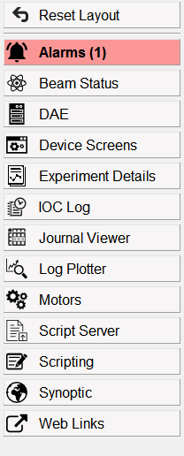
System Views
Investigate the system views and find out what they do
Notes:
Different System views we will look at some of them in the moment but take 5 minutes to have a quick look.

Slide 12
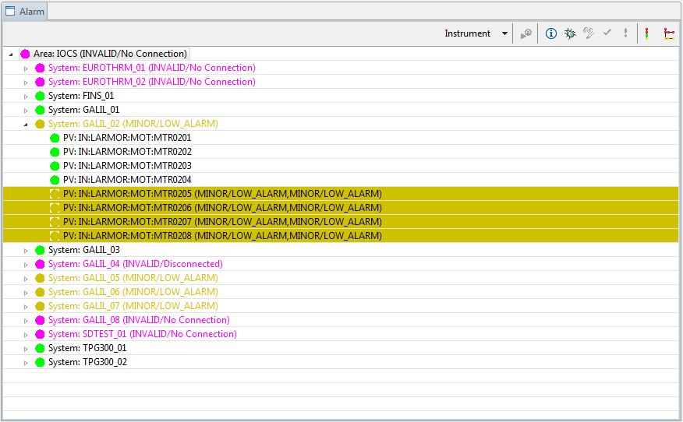
System Views: Alarms
Notes:
Alarm view is picture of problems on your instrument. You can drill down into the tree to show what the problems are.

Slide 13
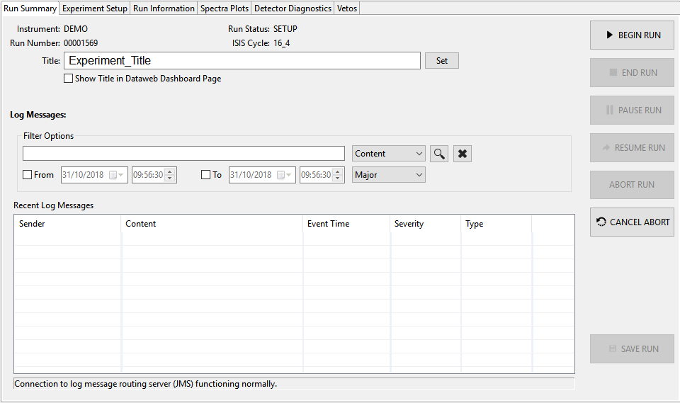
System Views: DAE
Notes:
DAE let you control the DAE Begin, end, etc.
Set title + visibility
See Log errors
Walk through

Slide 14
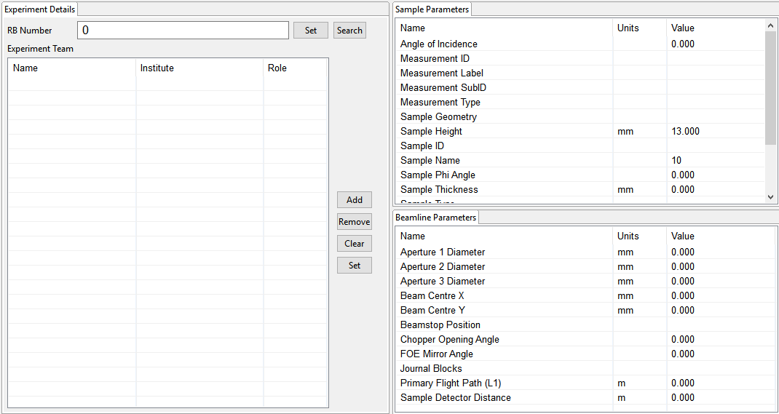
System Views:
Experiment Details
Notes:
Experiment details lets you fill out experiment details which are written into the DAE.

Slide 15
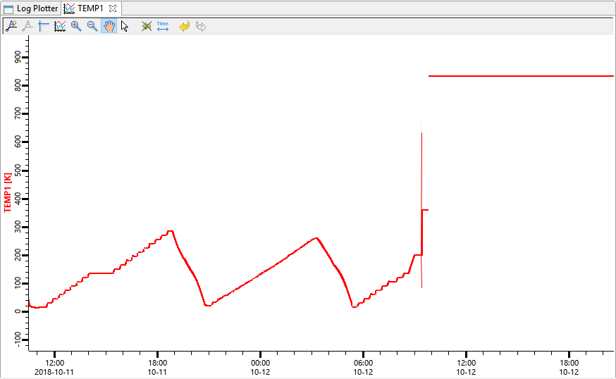
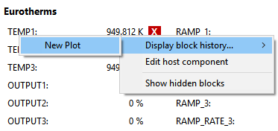
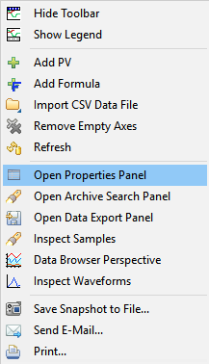
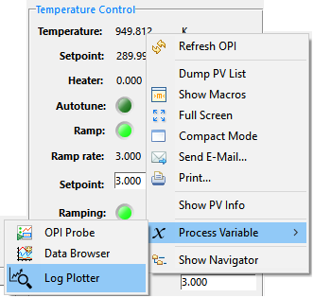
System Views: Log Plotter
From Blocks
From OPI
Notes:
The value of a PV can be plotted against time from a block or OPI. This may include historic data but will log future data.
Right click Properties: Trace display properties, time/value axis labels + scaling, redraw time, …

Slide 16
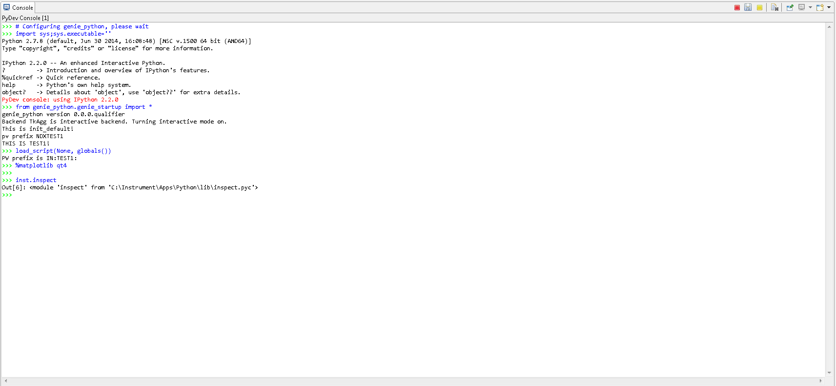
System Views: Scripting
Covered further in our course:
Introduction to genie_python

Slide 17
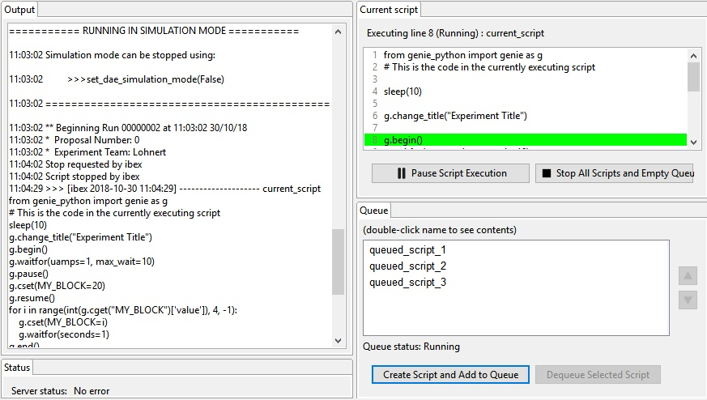
System Views: Script Server
Covered further in our course:
Introduction to genie_python

Slide 18
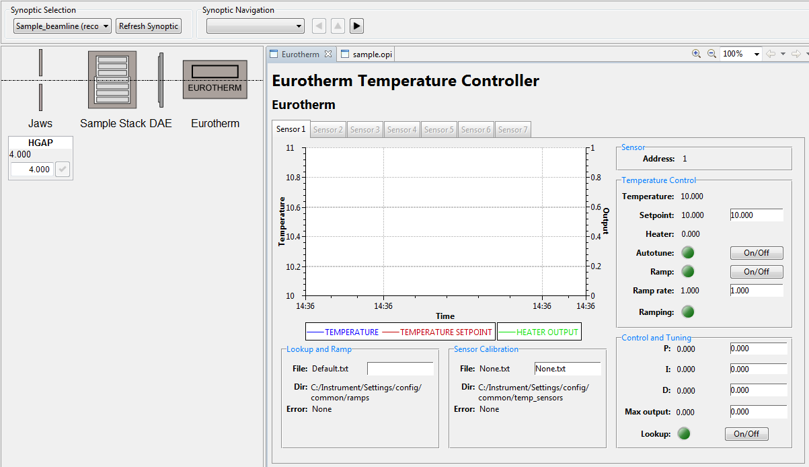
System Views: Synoptic
Notes:
Synoptics allow visualisation of the instrument.
Click to see an OPI which is a more detailed view of the component on the synoptic.
Users can create synoptics from the menu Synoptics -> New

Slide 19
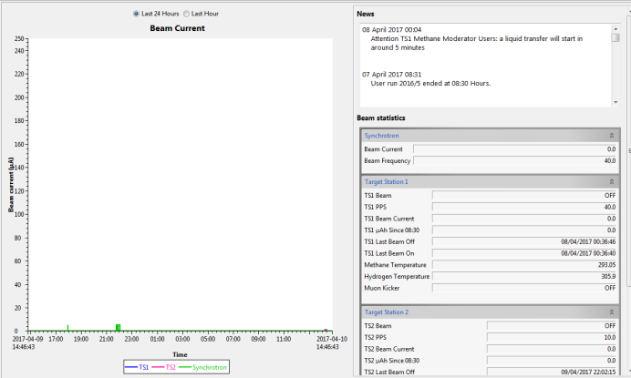
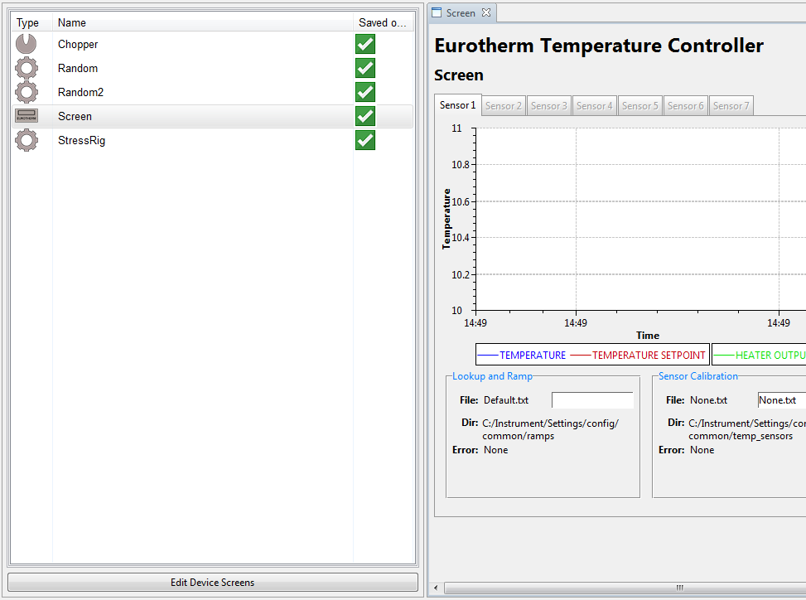
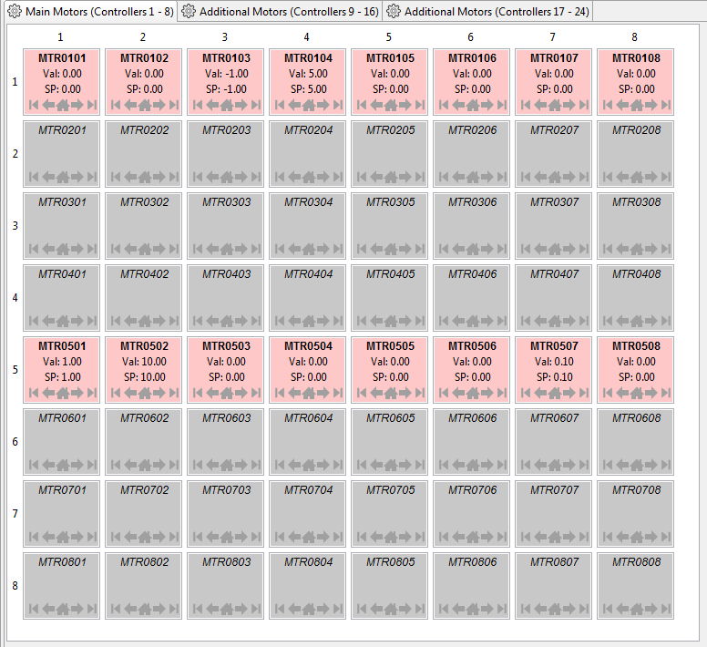
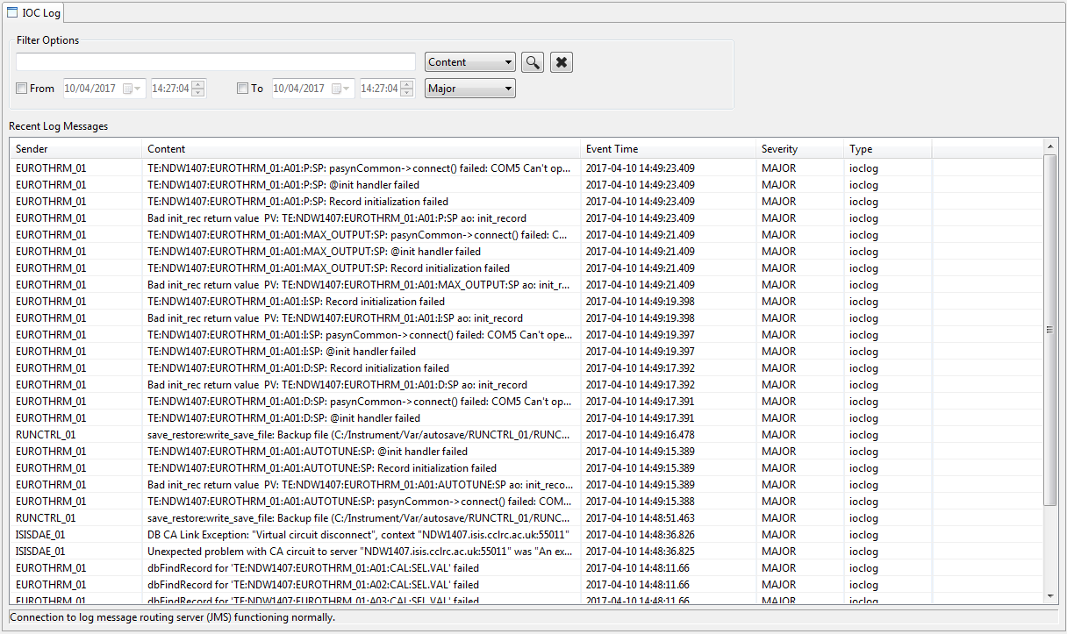
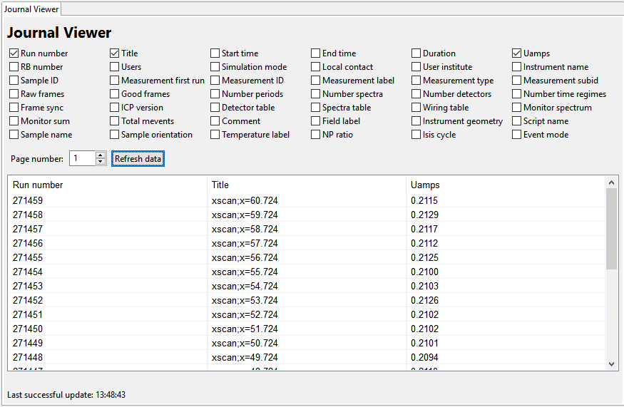
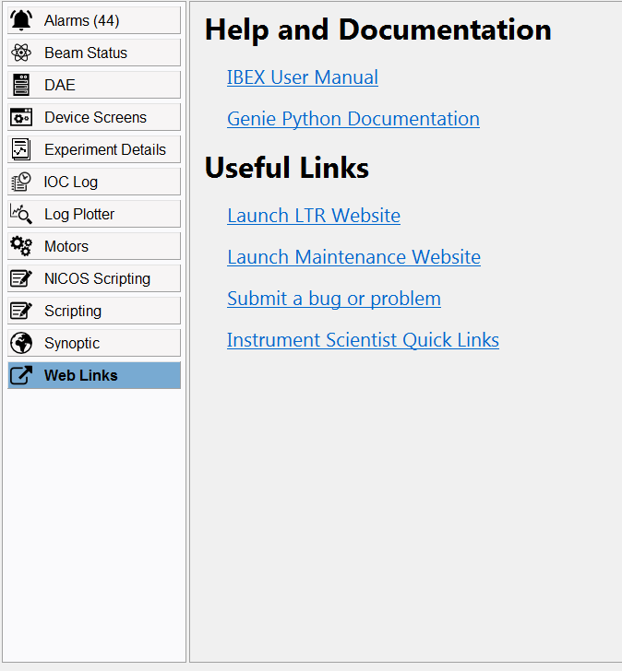
System Views: Other
Beam Status
Device Screens
Motors
IOC Log
Journal Viewer
Web Links
Notes:
There are many other system views:
Beam Status
Device Screens – synoptics without the beam
Motor – view of all motors on the system
IOC Log – information from the IOCs
Journal Viewer – shows runs + selected information
Web Links – useful links including user manual and error reporting

Slide 20
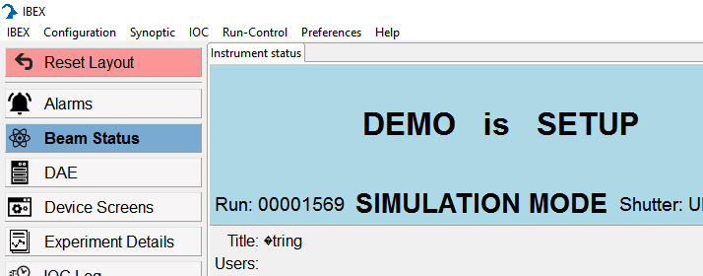
System Views: Dynamic Layout
“ViewParts” can be freely rearranged
Layout is per view
If anything goes funny – reset layout button
Future: Save layouts

Slide 21
Configurations

Slide 22
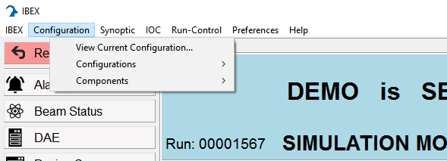
Configurations
If you edit the current configuration it will change the configuration on the server when it is saved
Manipulate configurations:
  New
  Load
  Edit (current and other)
  Copy (Hint: save as)
  Delete
Notes:
Configurations
Can edit configurations which are not the current config (different to SECI) - point out “Current Configuration” label)
Saving the current config applies the change immediately
Tasks are about manipulation of configuration not the contents

Slide 23
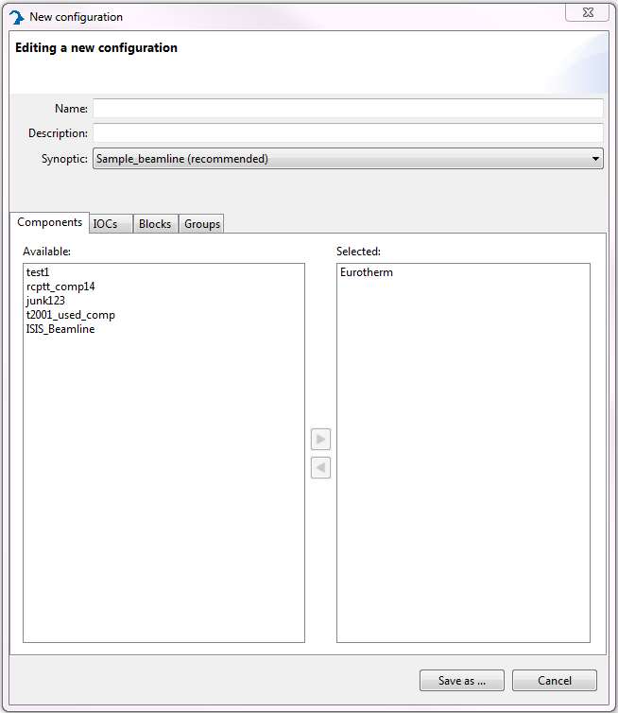
Configuration: Contents
Notes:
Configurations have:
Details (Name, description and default synoptic)
Components
IOCs
Blocks
Groups

Slide 24
Configuration: Components
Configuration
Beam Line Component
Temperature Component
Notes:
Make a configuration out of 0, 1 or many configuration components
Each configuration component is just a configuration (except it can not contain components)

Slide 25
Configuration: Components
Create a new component
Add it to an existing configuration

Slide 26
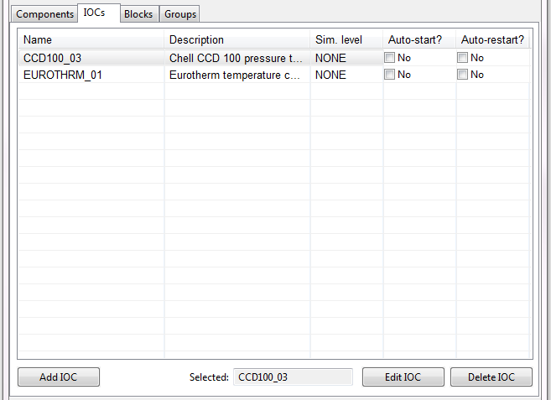
Configurations: IOC
Notes:
This is a list of IOCs in the current configuration – shows their description along with Sim level, whether they auto start or auto-restart
Buttons at the button add/edit/delete IOCs to the configuration

Slide 27
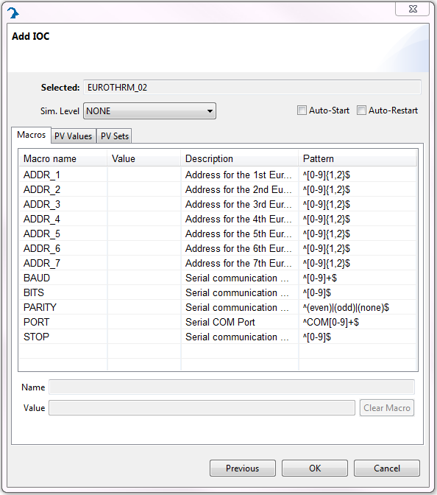
Configurations: Add IOC
IOC Settings
  Sim. Level
  Auto-Start
  Auto-restart
Add the SIMPLE IOC
Make it auto-start
Confirm IOC is running in the Start/Stop IOC dialog (access from menu bar)
Remove the SIMPLE IOC
Notes:
Adding is a two step process. First select the IOC from a list then configure it. On the configuration page
Sim level – probably not used on Experiment but does not talk to the device (not all IOCs have this at the moment so be careful)
Auto-start – on load IOC will start
Auto-restart – if the IOC dies it will be restarted
Will talk about macros next
Task: Find the SIMPLE in the list and click Auto-Start then save
Mention filter by IOCs in config

Slide 28
Configuration: IOC Macros
Set non-default macros for EUROTHRM_01
NB globals.txt overrides this
Notes:
IOC Macros Setup the device/IOC values. E.g. com port
Global.txt is in (in C:\Instrument\Settings\config\<instrument>\configurations)

Slide 29
Configuration: Blocks
Wrap interesting instrument control variables (EPICS PVs)
  To display with a descriptive alias
  To log its values
  To put it under run control

Slide 30
Configuration: PV Names
Variations
  TEMP – measurement of temperature
  TEMP:SP – set point for the temperature
  TEMP:SP:RBV – read back from the device of the set point
Instrument
IOC Device Name
Channel
Value
IN:DEMO:EUROTHRM_01:A01:TEMP
Notes:
To add a block we have to understand PVs. These are published values from the IOC. They have the form:
Instrument (IN for instruments, TE for private machines)
Device name (can be shortened form of real name)
Channel – this is optional and may have more than one part
Value – what is being measured
On top of these are the variations to allows setting and reading back from the instrument what it thinks is set

Slide 31
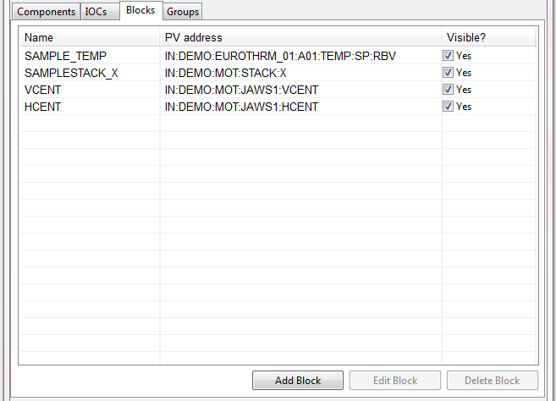
Configuration: Blocks
Add block for:
  PV TE:<INSTRUMENT NAME>:SIMPLE:VALUE1
Add blocks for other PVs from Simple using the search for other PVs (Hint play with the filters)
Logging and Run Control Settings
NB List of PVs is only updated on instrument start
after IOC is run
Notes:
1) Add a block (click add block copy PV address as PV give it a good name) see it appear in the Others group on the dash board
2) Look at search functionality to find PVs more easily, mention the filters
Run control can be set up from the block (there is also a separate menu item)

Slide 32
Configuration: Block Names
Block points at a PV
  CCRTEMP -> IN:DEMO:EUROTHRM_01:A01:TEMP
Blocks can be read using genie_python
  g.cget("CCRTEMP")
Blocks can be set using genie_python
  g.cset("CCRTEMP", 20)
  Under the hood this writes to IN:DEMO:EUROTHRM_01:A01:TEMP:SP
Notes:
When blocks are setup usually use PV bare name. You can also use fields but this is rarer.
Can be read in genie_python by using just the block name
Can be set by using genie under the hood it looks for a PV called <PV Name>:SP

Slide 33
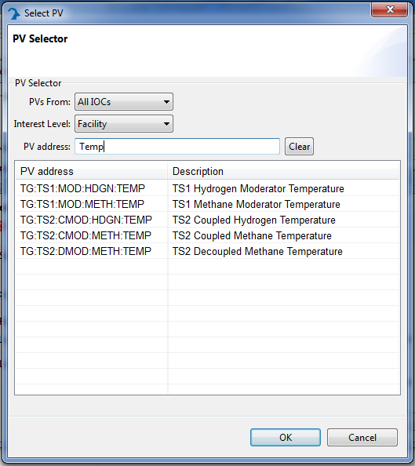
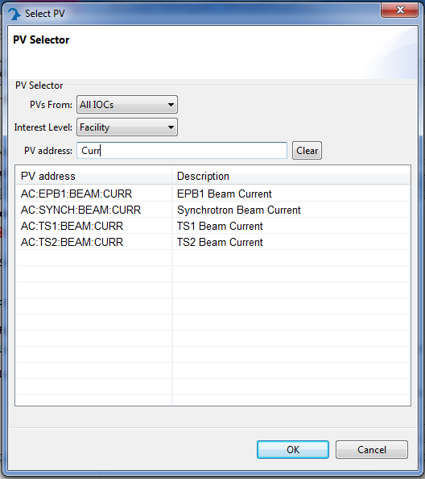
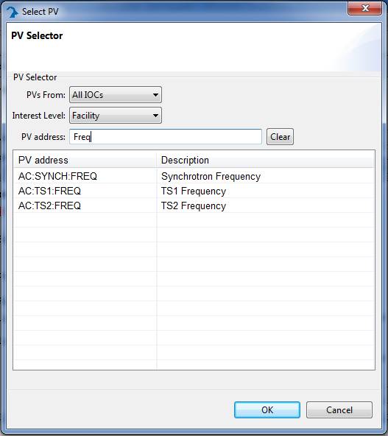
Facility PVs
Notes:
You can filter blocks by “Facility PVs”
This gives access to many central synchotron values
Don’t forget you can filter by description

Slide 34
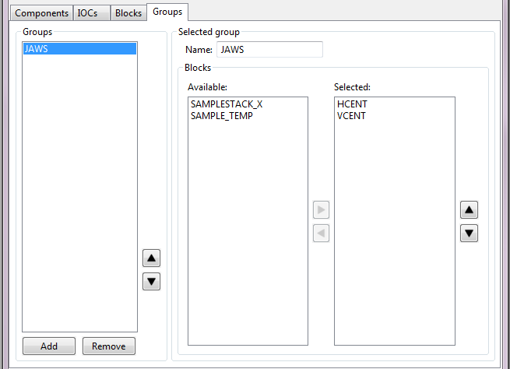
Configuration: Groups
Create a “simple” group
Add new blocks to it
Notes:
Click Add (bottom left), change name in selected group (Blank groups are not saved)
Select block from available and click arrow so it is selected

Slide 35
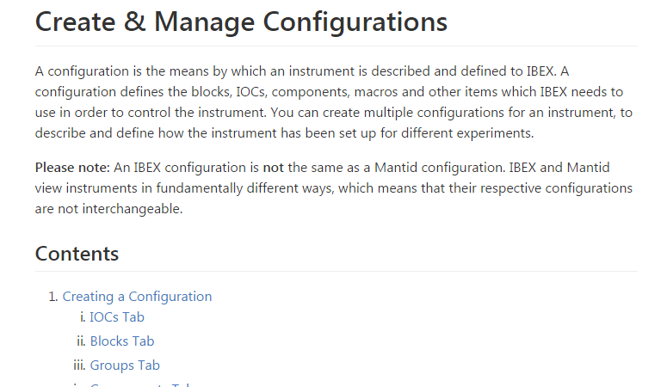
Configuration: Anything Else?
Anything else before moving to synoptics?
User manual
Notes:
Anything else

Slide 36
Synoptics

Slide 37
Synoptics: Overview
Current synoptic
OPI
Component
PVs
Notes:
Give an overview of a specific setup of the beamline.
The view contains a number of components:
A navigation bar
A list of components
PVs associated with particular components
OPIs (like VIs)

Slide 38
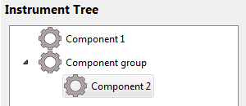
Synoptics: Structure
Synoptics
  made of components
Components
  Link to a particular piece of hardware
  Can open OPIs
  Can display and set values for particular PV
Component groups
  Component groups are components that contain other components
  Component groups are components; they can also open OPIs, have PVs etc.

Slide 39
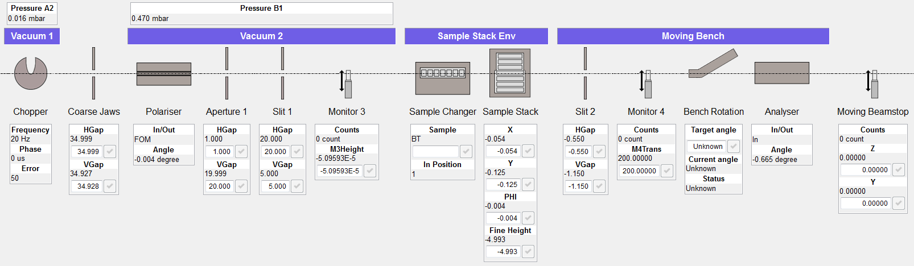
Synoptics: Example
Component groups PVs
Component group
Component
Component PVs

Slide 40
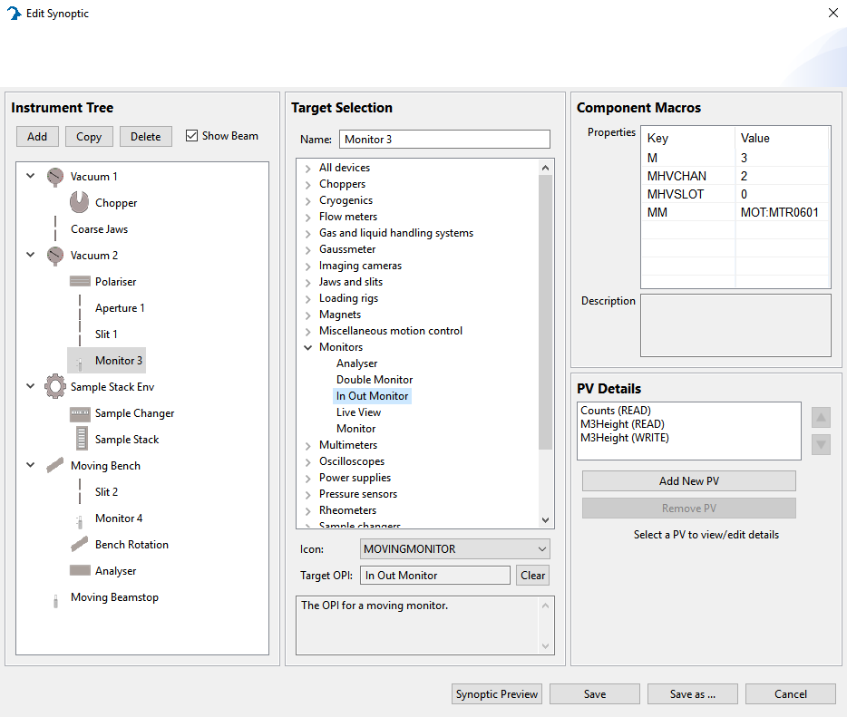
Synoptics: Example
Target OPI (Interface)
Macros
Components
Component PVs
Notes:
Groups: Components with nested components
Target OPI: Devices are in all appropriate categories

Slide 41
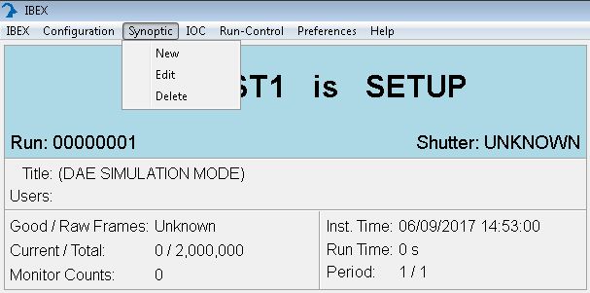
Synoptics: New, edit, delete
Create a new synoptic called “delete_this_synoptic”
Delete the synoptic named “delete_this_synoptic”
Create a new synoptic called “my_synoptic”
Open the edit dialog for “my_synoptic”
Notes:
Let users play with the new, edit and delete options. The dialogs for each should be self-explanatory once they’ve been pointed at the correct menu

Slide 42
Synoptics: Instrument tree
Create/copy/delete components using controls at bottom
Drag and drop components to reorder them
Drag one component onto another to create or add to a group

Slide 43
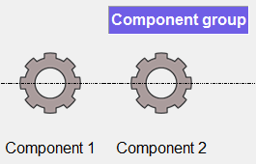
Synoptics: Instrument tree
Open the synoptic editor for my_synoptic
Create an instrument tree as shown
Save the synoptic
Select the synoptic. It should look as below

Slide 44
Synoptics: Component details
Each component has the following user-defined properties
  Name: Displayed in the synoptic view
  Target: Determines the OPI that this item points at
  PVs: Covered later

Slide 45
Synoptics: Component details
Open the editor for my_synoptic
Change the name of Component A to Eurotherm
Under the Temperature Controllers heading, select EUROTHERM.
Save the synoptic
Refresh the synoptic, how has it changed?

Slide 46
Synoptics: Macros
Some targets have macros. These tell the component how to set up the OPI correctly to point at a piece of hardware
Each macro has a description and usually a default value as a hint

Slide 47
Synoptics: Target details
Open the synoptic editor for my_synoptic
Select the Eurotherm component
Set the value for the macro: EUROTHRM_01
Save the synoptic

Slide 48
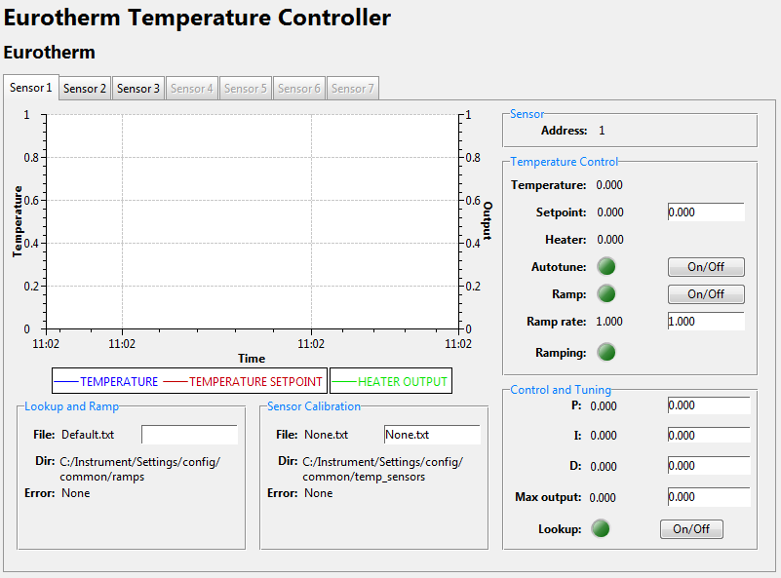
Synoptics: Target details
Click on the Eurotherm component in the synoptic.
It should open an OPI that looks like this:
If you have lots of purple disconnected boxes still, check your macro values or ask your IBEX trainer
Notes:
Set the Eurotherm to recsim so we can play around with it

Slide 49
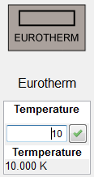
Synoptics: PV details
You can display read and write PV values alongside your components
Notes:
Show the things you can do by right clicking on a control
Get PV info
Send to log plotter
Open an OPI with a graph and show that you can add control bars to allow panning
Caution against using particular controls that can mess up the GUI

Slide 50
Synoptics: PV details
Open the synoptic editor for my_synoptic
Select the Eurotherm component
Click Add New PV and give it the following properties:
  Name: Temperature
  Mode: Read
Do the same again with the following properties:
  Name: Temperature setpoint
  Mode: Write
Use the Select block dialog to give them each an appropriate PV value

Slide 51
Synoptics: PV details
Save the synoptic. It should now look like this:
Try changing the temperature setpoint. Verify it changes to readback

Slide 52
Basic Scripting
Full scripting covered in:
Introduction to genie_python
Notes:
Emphasise that these slides will only give the basics and to write full scripts for the instrument you should attend Introduction to genie_python

Slide 53
Scripting: Getting started
Open a scripting window in IBEX
Output "Hello, world!" to the console
Notes:
The best way to run genie_python commands is from the scripting perspective of the IBEX client.
To open a scripting window:
Open the scripting perspective
The exercise is mostly a warm up to make sure:
They have prerequisite Python knowledge

Slide 54
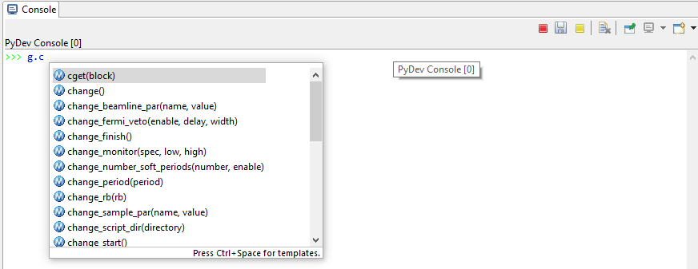
Scripting: Calling functions
Access functions via the ‘g’ namespace.
  For example: g.get_version()
Autocomplete will suggest available functions:
  (CTRL + . brings it back up)
Notes:
Functions accessed via the ``g`` namespace
You should have noticed immediately after you typed ``g.`` that an auto-complete window appeared:
The window lists the available commands, and the arguments they take, in brackets.
A description of the highlighted functions and its arguments is also given.
The list will be refined as you type more characters.

Slide 55
Scripting: Common commands
g.begin(): Begins a new run
g.end(): Ends the current run
g.change_title("New title"): Change the title
g.cget("MY_BLOCK"): Gets the value of a block
g.cset("MY_BLOCK", 1): Sets value of a block
Run some of the commands above
Use autocomplete to experiment with other commands
Notes:
Run through the basic commands
Allow a bit of time for users to experiment

Slide 56
Scripting: Running other scripts
Python scripts are files with the extension .py. These makes complex code easier to edit and maintain
Scripts can use any Python and genie_python functionality.
Two types of scripts in IBEX:
  Instrument scripts. Aimed at instrument scientists, or instrument-specific functions that multiple users may wish to access. To run use: inst.my_method("MY_BLOCK")
  User scripts. Specific users need for particular experiments, these are stored in C:\Scripts\. To run use: g.load_script("run_my_experiment.py")
Notes:
Explain the running of pre-existing scripts, suggest the full course if people want to be writing/editing their own scripts

Slide 57



Scripting: Script Server
Commands
Scipting console:
Client
NDX
Script
Script Server:
Results
Client
NDX
Notes:
Explain the running of pre-existing scripts, suggest the full course if people want to be writing/editing their own scripts

Slide 58
Scripting: Script Server
Current functionality:
  Execute a queue of scripts
  Display currently executing script and line
  Pause / resume script execution
More work planned
Notes:
Future functionality:
- Syntax highlighting/suggestions
Similar to existing scripting window
- Time estimation?
- Dry runs of scripts?
- Python 3
At the same time as mantid
- Stepping through scripts one line at a time
- Editing a script on the fly

Slide 59
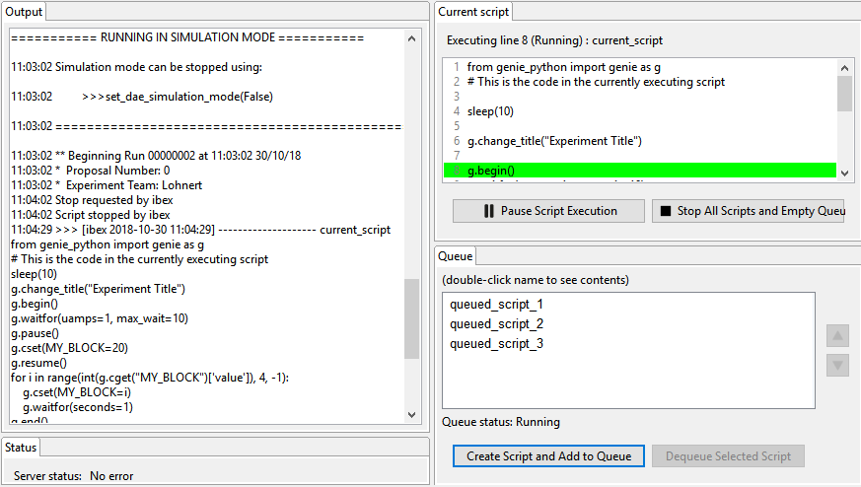
ScriptServer
Notes:
Explain the running of pre-existing scripts, suggest the full course if people want to be writing/editing their own scripts

Slide 60
References
User Manual
  http://shadow.nd.rl.ac.uk/ibex_user_manual/Home
Genie Python Manual
  http://shadow.nd.rl.ac.uk/genie_python/sphinx/genie_python.html
Notes:
User manual and genie python manual

Slide 61
Feedback
Fill out survey at …
To improve
  Topics to add/remove
  Additional reading material before/after training?
Notes:
Ask who is returning after lunch – can stay logged in

Slide 62











Reference card
Component
OPI
Synoptic
Block
PV
Configuration
Group
Device
Component
IOC

Slide 63
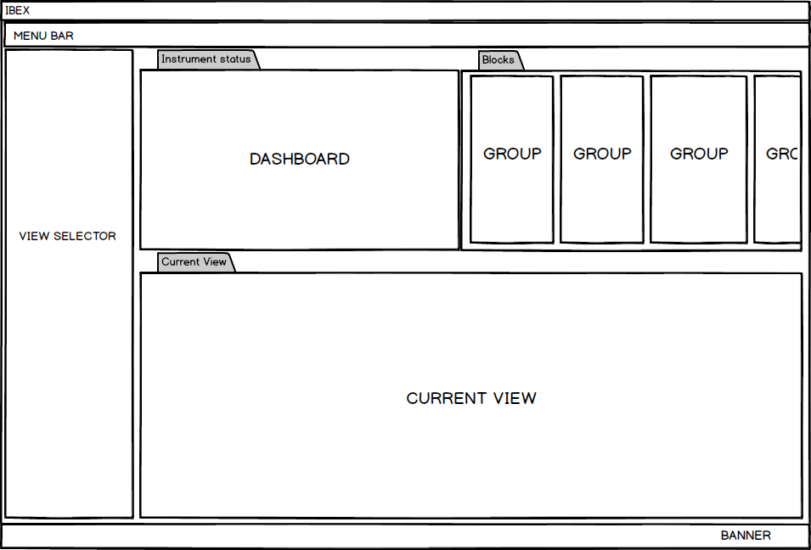
GUI Reference Card

Slide 64
Useful Locations
IBEX server:
C:\Instrument\Apps\EPICS\start_ibex_server.bat
C:\Instrument\Apps\EPICS\stop_ibex_server.bat
IBEX client:
C:\Instrument\Apps\Client_E4\IBEX-Client.exe
Instrument Scripts:
C:\Instrument\Settings\config\<Instrument name>\Python\inst\
User Scripts:
C:\Scripts\

